Slide 1
Deep Neural Networks for YouTube Recommendation

Slide 2
PPT模板下载：www.1ppt.com/moban/ 行业PPT模板：www.1ppt.com/hangye/
节日PPT模板：www.1ppt.com/jieri/ PPT素材下载：www.1ppt.com/sucai/
PPT背景图片：www.1ppt.com/beijing/ PPT图表下载：www.1ppt.com/tubiao/
优秀PPT下载：www.1ppt.com/xiazai/ PPT教程： www.1ppt.com/powerpoint/
Word教程： www.1ppt.com/word/ Excel教程：www.1ppt.com/excel/
资料下载：www.1ppt.com/ziliao/ PPT课件下载：www.1ppt.com/kejian/
范文下载：www.1ppt.com/fanwen/ 试卷下载：www.1ppt.com/shiti/
教案下载：www.1ppt.com/jiaoan/ PPT论坛：www.1ppt.cn
Part 1
Introduction
Part 2
Candidate Generation
Part 3
Ranking

Slide 3
Part 1
Part 1
Introduction

Slide 4

YouTube Recommendation
YouTube is the world's largest platform for creating, sharing and discovering video content. YouTube recommendations are responsible for helping more than a billion users discover personalized content from an evergrowing corpus of videos.

Slide 5
Challenges
Scale:Highly specialized distributed learning algorithms + effcient serving systems
Freshness:Timeliness Response+Balance
Noise: Robust

Slide 6
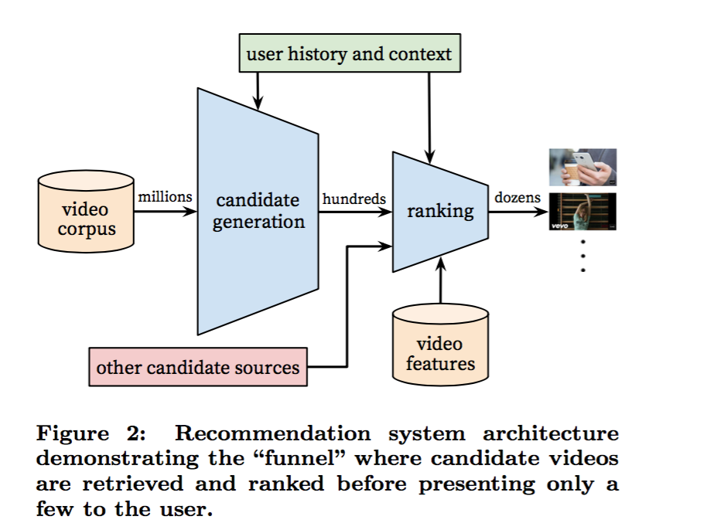
System Overview
Candidate generation+Ranking
The candidate generation network takes events from the user’s YouTube activity history as input and retrieves a small subset (hundreds) of videos from a large corpus.
The ranking network accomplishes this task by assigning a score to each video according to a desired objective function using a rich set of features describing the video and user.

Slide 7
System Overview
The two-stage approach to recommendation allows us to make recommendations from a very large corpus (millions) of videos while still being certain that the small number of videos appearing on the device are personalized and engaging for the user.
Development:A/B test
offline metrics (precision, recall, ranking loss, etc.)+live experiments( click-through rate,watch time, and many other metrics that measure user engagement)

Slide 8
Part 2
Part 2
Candidate Generation

Slide 9

Recommendation as Classification
We pose recommendation as extreme multiclass classification where the prediction problem becomes accurately classifying a specific video watch wt at time t among millions of videos i (classes) from a corpus V based on a user U and context C,
where u ∈ R N represents a high-dimensional “embedding” of
the user, context pair and the vj ∈ R N represent embeddings of each candidate video.

Slide 10
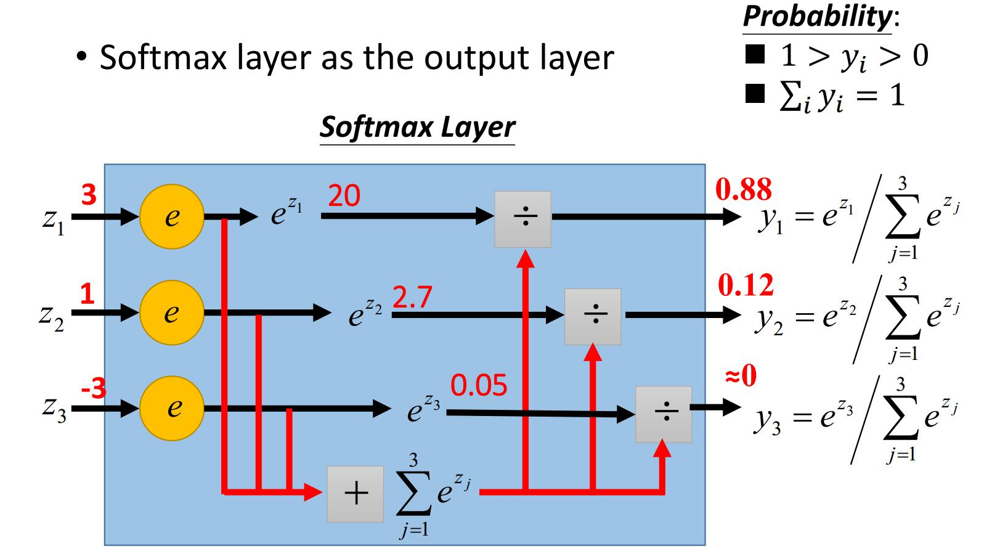
Recommendation as Classification

Slide 11
Efficient Extreme Multiclass
explicit feedback+implicit feedback
cross entropy loss

Slide 12
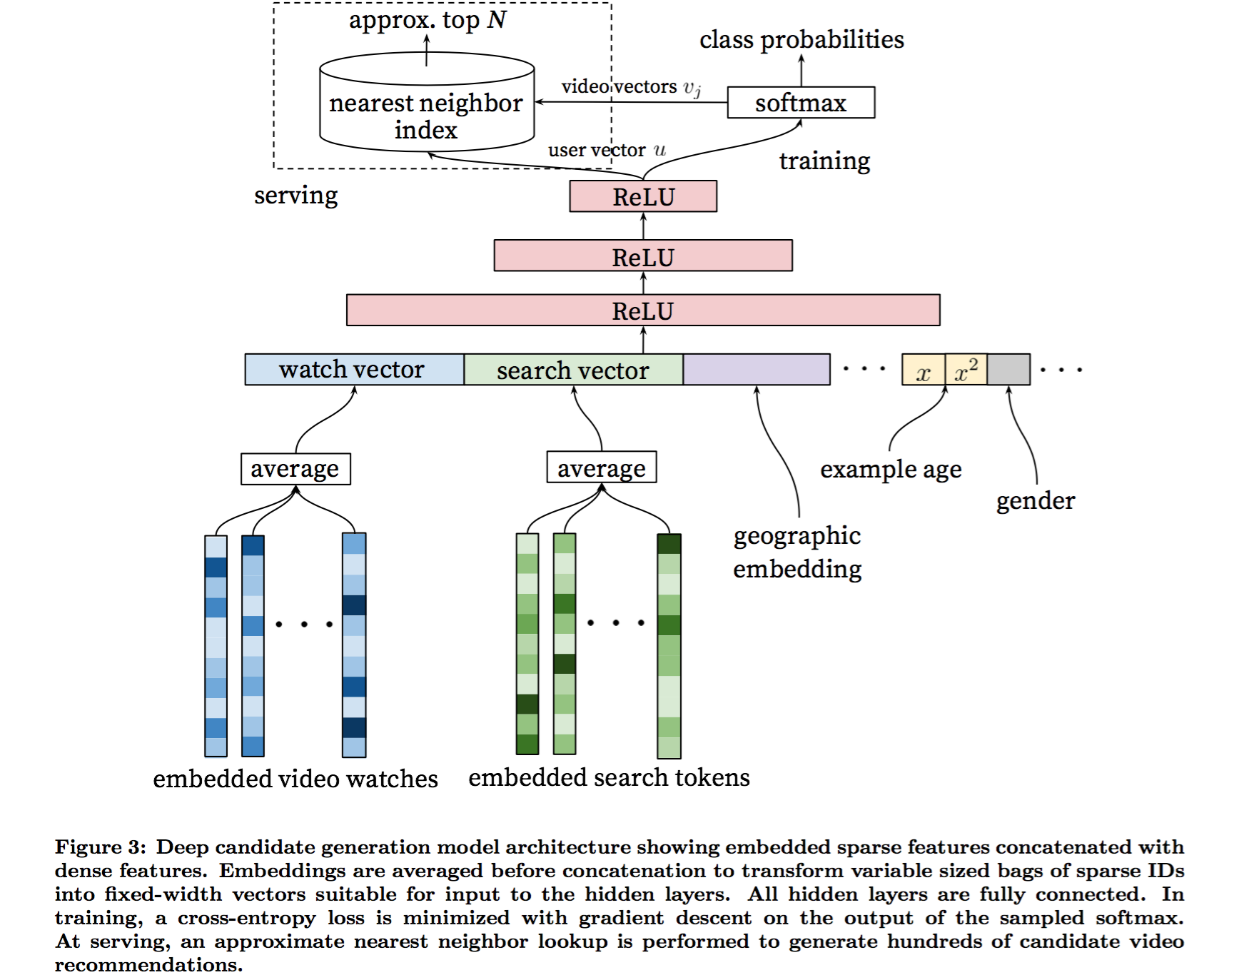
Model Architecture
Inspired by continuous bag of words language models ,we learn high dimensional embeddings for each video in a fixed vocabulary and feed these embeddings into a feedforward neural network. A user’s watch history is represented by a variable-length sequence of sparse video IDs which is mapped to a dense vector representation via the embeddings. The network requires fixed-sized dense inputs and simply averaging the embeddings performed best among several strategies (sum, component-wise max, etc.).

Slide 13
Heterogeneous Signals
Search history
Demographic features
The user's geographic region and device

Slide 14
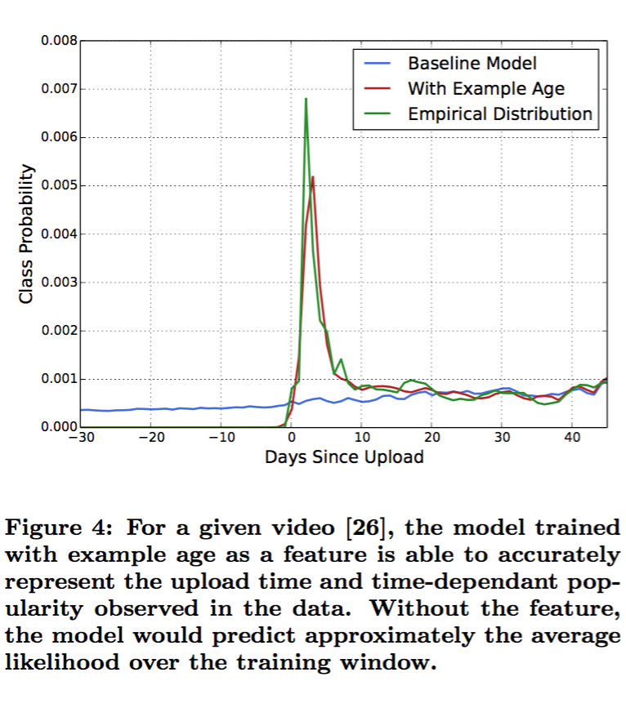
Heterogeneous Signals
“Example Age” Feature

Slide 15
label and context selection
Training examples are generated from all YouTube watches
generate a fixed number of training examples per user
abandon information from the classifier
asymmetric co-watch

Slide 16
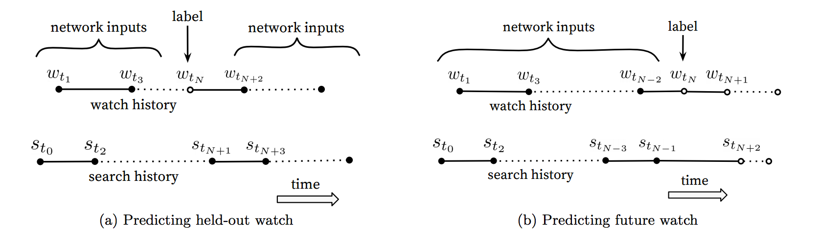
label and context selection
asymmetric co-watch

Slide 17
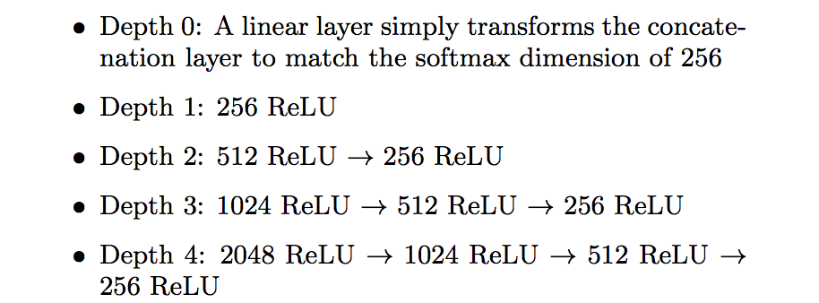
Experiments with Features and Depth

Slide 18
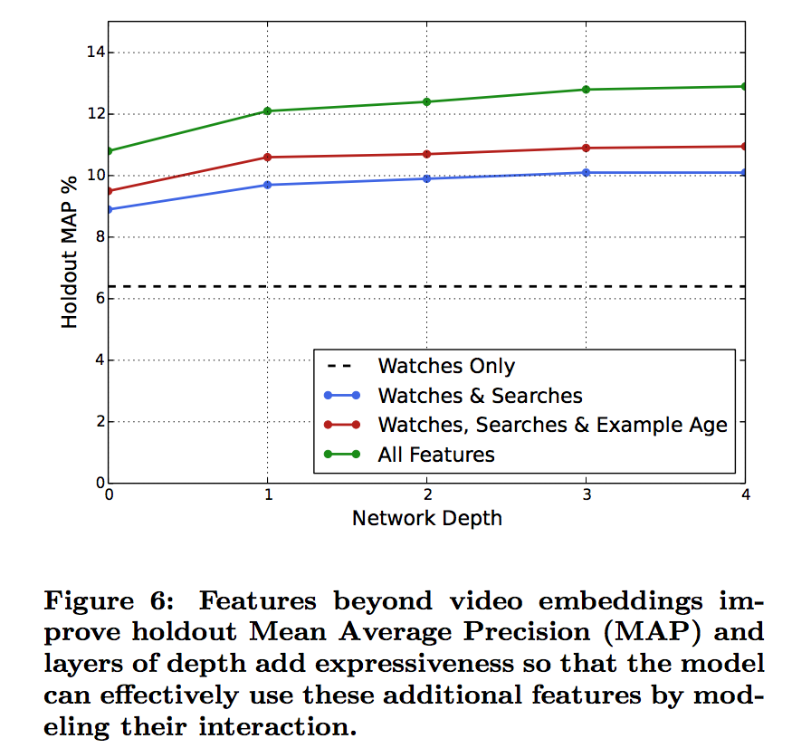
Experiments with Features and Depth

Slide 19
Part 3
Part3
Ranking

Slide 20
Feature Engineering
The main challenge is in representing a temporal sequence of user actions and how these actions relate to the video impression being scored.
The most important signals are those that describe a user’s previous interaction with the item itself and other similar items.
Features describing the frequency of past video impressions are also critical for introducing “churn” in recommendations.

Slide 21
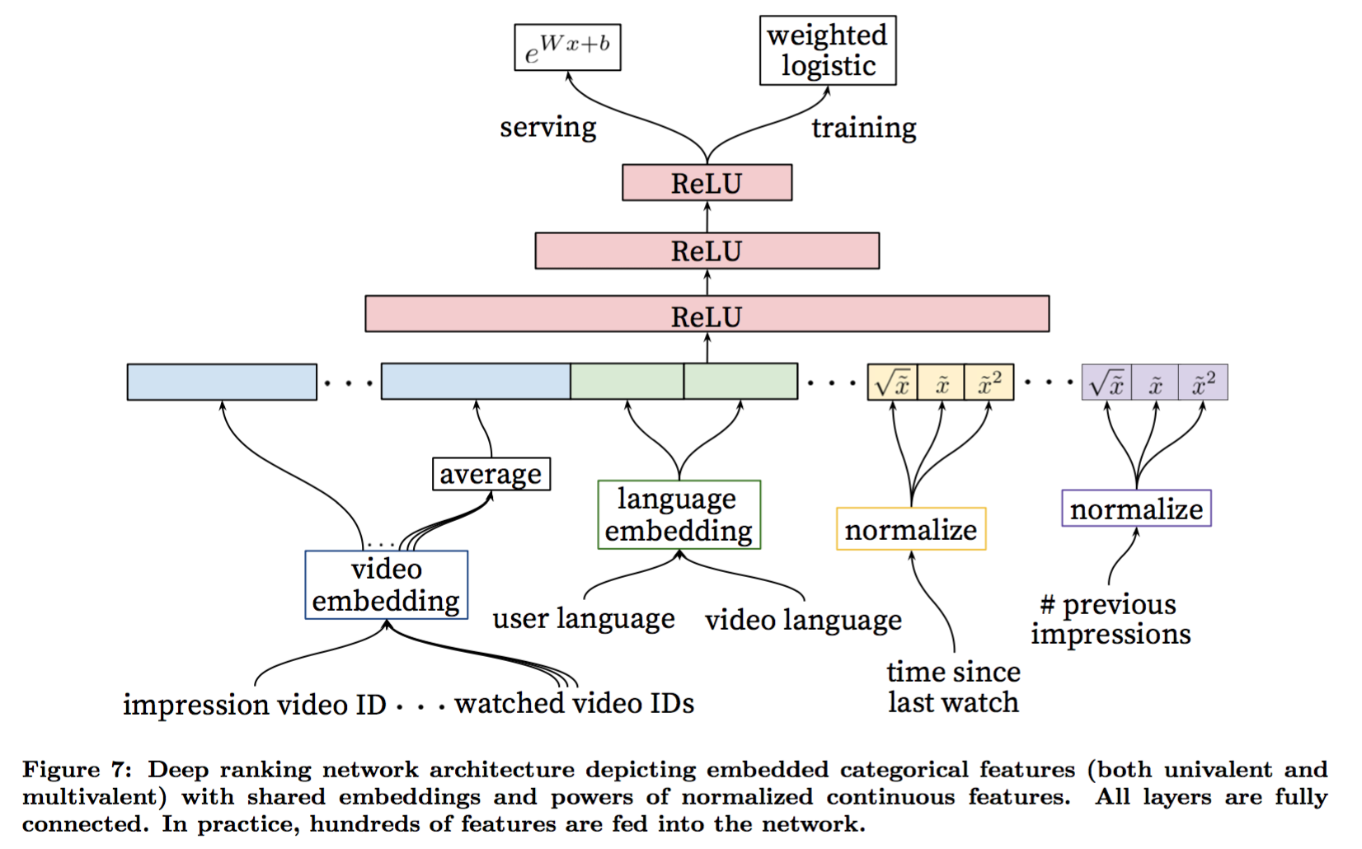
Modeling Expected Watch Time

Slide 22

Modeling Expected Watch Time
Our goal is to predict expected watch time given training examples that are either positive (the video impression was clicked) or negative (the impression was not clicked).
the odds learned by the logistic regression are:
where N is the number of training examples,k is the number of positive impressions, and Ti is the watch time of the ith impression

Slide 23
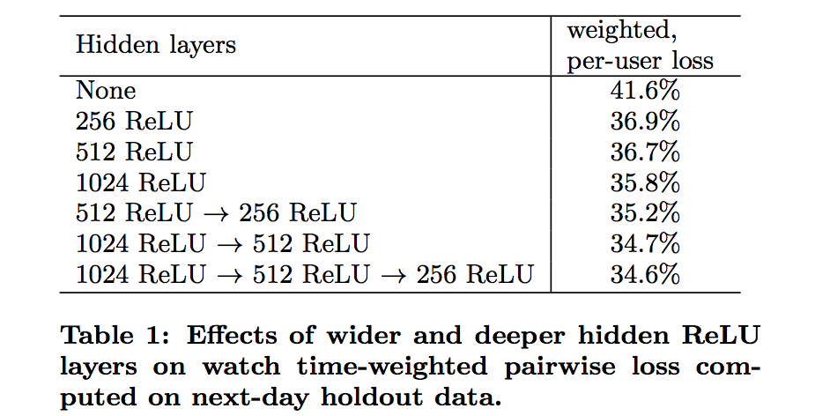
Experiments with Hidden Layers
These results show that increasing the width of hidden layers improves results, as does increasing their depth.

Slide 24
Experiments with Hidden Layers
Table 1 shows the results we obtained on next-day holdout
data with different hidden layer configurations.

Slide 25
Thank you!!

